Slide 1
From Strings to Things: Populating Knowledge Bases from Text
Tim Finin
University of Maryland, Baltimore County
Joint work with colleagues and students at the JHU Human Language Technology Center of Excellence
And University of Maryland, Baltimore County
2018-02-09

Slide 2
TL;DR
I’ll describe the NIST TAC Knowledge Base Population tasks and the Kelvin system we developed to participate in it

Slide 3

NIST Text Analysis Conference
Annual evaluation workshops since 2008 on natural language processing & related applications with large test collections and common evaluation procedures
Knowledge Base Population (KBP) tracks focus on building KBs from information extracted from text
Cold Start KBP: construct KB from text w/o using external KBs
Entity discovery & linking: cluster and link entity mentions
Slot filling
Slot filler validation
Sentiment
Events: discover and cluster events in text
http://nist.gov/tac

Slide 4
2017 TAC Cold Start KBP
Read 90K documents: newswire articles & social media posts in English, Chinese and Spanish
Find entity mentions, types & relations (optionally plus events & sentiment) using a shared schema
Cluster entities & events in/across documents, link to reference KB if possible (which George Bush)
Remove errors (Obama born in Illinois), draw sound inferences (Malia and Sasha sisters)
Create graph with provenance (+ optional confidence score) in TAC format

Slide 5
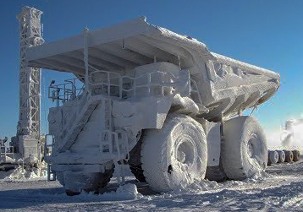
Cold Start ?
Goal: reduce focus on popular entities common in newswire
Start with empty KB
All facts must be attested in text
Can’t use external KBs (e.g., Wikidata) or Web searches

Slide 6
2017 TAC Cold Start KBP
<DOC id="APW_ENG_20100325.0021" type="story" >
<HEADLINE>
Divorce attorney says Dennis Hopper is dying
</HEADLINE>
<DATELINE>
LOS ANGELES 2010-03-25 00:15:51 UTC
</DATELINE>
<TEXT
<P>
Dennis Hopper's divorce attorney says in a court filing that the actor is dying and can't undergo chemotherapy as he battles prostate cancer.
</P>
<P>
Attorney Joseph Mannis described the "Easy Rider" star's grave condition in a declaration filed Wednesday in Los Angeles Superior Court.
</P>
<P>
Mannis and attorneys for Hopper's wife Victoria are fighting over when and whether to take the actor's deposition.
</P> …
Read 90K documents: newswire articles & social media posts in English, Chinese and Spanish
Find entity mentions, types & relations (optionally events & sentiment) using a shared schema
Cluster entities & events in/across documents, link to reference KB if possible (which George Bush)
Remove errors (Obama born in Illinois), draw sound inferences (Malia and Sasha sisters)
Create graph with provenance in TAC format

Slide 7
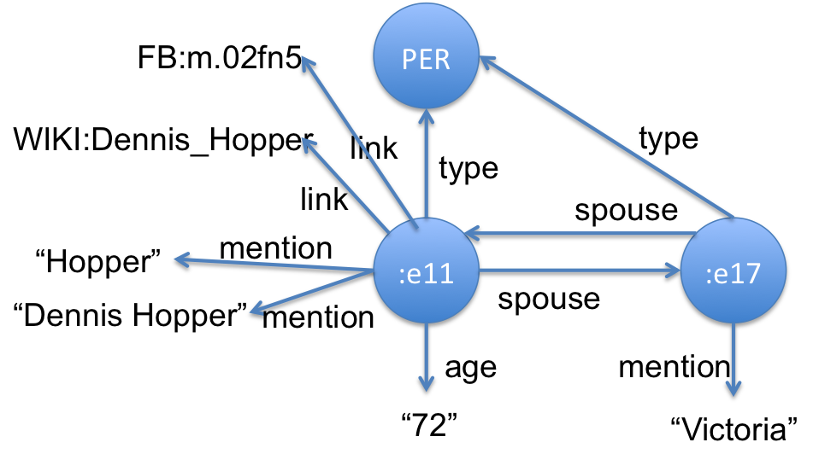
2017 TAC Cold Start KBP
<DOC id="APW_ENG_20100325.0021" type="story" >
<HEADLINE>
Divorce attorney says Dennis Hopper is dying
</HEADLINE>
<DATELINE>
LOS ANGELES 2010-03-25 00:15:51 UTC
</DATELINE>
<TEXT
<P>
Dennis Hopper's divorce attorney says in a court filing that the actor is dying and can't undergo chemotherapy as he battles prostate cancer.
</P>
<P>
Attorney Joseph Mannis described the "Easy Rider" star's grave condition in a declaration filed Wednesday in Los Angeles Superior Court.
</P>
<P>
Mannis and attorneys for Hopper's wife Victoria are fighting over when and whether to take the actor's deposition.
</P> …
Read 90K documents: newswire articles & social media posts in English, Chinese and Spanish
Find entity mentions, types & relations (optionally events & sentiment) using a shared schema
Cluster entities & events in/across documents, link to reference KB if possible (which George Bush)
Remove errors (Obama born in Illinois), draw sound inferences (Malia and Sasha sisters)
Create graph with provenance in TAC format

Slide 8
2017 TAC Cold Start KBP
<DOC id="APW_ENG_20100325.0021" type="story" >
<HEADLINE>
Divorce attorney says Dennis Hopper is dying
</HEADLINE>
<DATELINE>
LOS ANGELES 2010-03-25 00:15:51 UTC
</DATELINE>
<TEXT
<P>
Dennis Hopper's divorce attorney says in a court filing that the actor is dying and can't undergo chemotherapy as he battles prostate cancer.
</P>
<P>
Attorney Joseph Mannis described the "Easy Rider" star's grave condition in a declaration filed Wednesday in Los Angeles Superior Court.
</P>
<P>
Mannis and attorneys for Hopper's wife Victoria are fighting over when and whether to take the actor's deposition.
</P> …
Read 90K documents: newswire articles & social media posts in English, Chinese and Spanish
Find entity mentions, types & relations (optionally events & sentiment) using a shared schema
Cluster entities & events in/across documents, link to reference KB if possible (which George Bush)
Remove errors (Obama born in Illinois), draw sound inferences (Malia and Sasha sisters)
Create graph with provenance in TAC format
…
:e00211 type PER
:e00211 link FB:m.02fn5 0.95
:e00211 link WIKI:Dennis_Hopper
:e00211 mention "Dennis Hopper" APW_021:185-197 1.0
:e00211 mention "Hopper" APW_021:507-512 1.0
:e00211 mention "Hopper" APW_021:618-623 1.0
:e00211 mention "丹尼斯·霍珀” CMN_011:930-936 1.0
:e00211 per:spouse :e00217 APW_021:521-528 1.0
:e00217 per:spouse :e00211 APW_021:521-528 1.0
:e00211 per:age "72" APW_021:521-528 0.9
…

Slide 9

KB Evaluation Methodology
Evaluating KBs extracted from 90K documents is non-trivial
TAC’s approach is simplified:
Fix the ontology of entity types and relations
Specify a serialization as triples + provenance
Sample a KB using a set of queries grounded in an entity mention found in a document
Get ground truth for queries and assess results
Given a KB, we can then evaluate its precision and recall for a set of queries
Notes:
Consider the graph isomorphis problem

Slide 10
KB Evaluation Methodology
A query: What schools were attended by children of entity mentioned in document #45611 at characters 401-412
That mention is George Bush which a system under test identifies as :e629 (i.e., G.H.W. Bush)
A query finds answer entities in a test system’s graph (e.g., Yale, Harvard, Tulane, UT Austin, UVA …) along with the provenance strings for the two relations
Assessors determine good answers in corpus and check the submitted results’ provenance

Slide 11

TAC Ontology
Derived from the Automatic Content Extraction (ACE) ontology
Entity types: PER (people), ORG (organizations), GPE (geopolitical entities), LOC (locations) and FAC (facilities)
Entity mentions: both name & nominal mentions
41 relations (plus inverses): entity to entity/string
18 event types: plus 85 event argument relations
2 sentiment relations (plus inverses): entity to entity

Slide 12
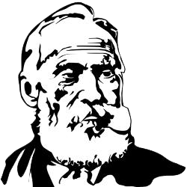
Kelvin
KELVIN: Knowledge Extraction, Linking, Validation and Inference
Developed at the Human Language Technology Center of Excellence at JHU and used in TAC KBP (2010-17), EDL (2015-17) and other projects
Takes English, Chinese & Spanish documents and produce a knowledge graph in several formats
We’ll review its monolingual pipeline, look at the multi-lingual use case

Slide 13

1 Information Extraction
1
documents
1
IE
Process documents in parallel on a grid
Apply an ensemble of NLP tools (e.g., language ID, Serif, CoreNLP, …) to find document-level mentions, entities, relations and events
Produce an Apache Thrift object for each document with text and extracted data using Concrete, a common NLP schema
2
TAC
3
CR
4
KB
5
MAT
KBs

Slide 14
2 Integrating NLP data
2
documents
IE
Process Concrete objects in parallel to:
Integrate data from tools (e.g., Serif, CoreNLP, OpenIE)
Fix problems, e.g., trim mentions, find missed mentions, deconflict tangled mention chains, …
Extract relations from events (life.born => date and place of birth)
Map relations found by open IE systems to TAC ontology (“is engineer at” => per:employee_of)
Map schema to our extended TAC ontology
30K ENG: 430K entities; 1.8M relations
1
2
TAC
3
CR
4
KB
5
MAT
KBs

Slide 15
3 Kripke: Cross-Doc Coref
3
documents
Cross-document co-reference creates initial KB from the document-level data
Identify that Barack Obama entity in DOC32 is same individual as Obama in DOC342, etc.
Language agnostic; works well for ENG, CMN, SPA document collections
Uses entity type and mention strings and context of co-mentioned entities
Untrained, agglomerative clustering
30K ENG: 210K entities; 1.2M relations
1
IE
2
TAC
3
CR
4
KB
5
MAT
KBs
Notes:
Superkripke == True => use nominal mentions

Slide 16
4 Inference & adjudication
4
documents
IE
Reasoning to
Delete relations violating ontology constraints
Person can’t be born in an organization
Person can’t be her own parent or spouse
Infer missing relations
Two people sharing a parent are siblings
X born in place P₁, P₁ part of P₂ => X born in P₂
Person probably citizen of their country of birth
A CFO is a per:top_level_employee
1
2
TAC
3
CR
4
KB
5
MAT
KBs
Notes:
Overview of pipeline step 3 – note that the number of facts is reduced still more.

Slide 17

Entity Linking
4
documents
1
IE
Try to links entities to reference KB, a subset of Freebase with
~4.5M entities and ~150M triples
Names and text in English, Spanish and Chinese
Don’t link if no matches, poor matches or ambiguous matches
2
TAC
3
CR
4
KB
5
MAT
KBs

Slide 18

KB-level merging rules
4
documents
Merge entities linked to same external KB entity
Merge cities in same region with same name
Highly discriminative relations give evidence of sameness
per:spouse is few to few
org:top_level_employee is few to few
Merge PERs with similar names who were
Both married to the same person, or
Both CEOs of the same company, or …
1
IE
2
TAC
3
CR
4
KB
5
MAT
KBs

Slide 19
Slot Value Consolidation
4
documents
Problem: too many values for some slots, especially for ‘popular’ entities, e.g.,
An entity with 2 per:city_of_birth values
Obama had ~100 per:employee_of values
Strategy: rank values and select best
Rank values by # of attesting docs and certainty scores
Choose best N values depending on relation type and distribution of frequency counts
30K ENG: 183K entities; 2.1M relations
1
IE
2
TAC
3
CR
4
KB
5
MAT
KBs
Notes:
Understudied problem: oral surgeon vs. dentist; how many subsidiary orgs does the USG have?
-13% entities, +25+ relations

Slide 20
Materialize KB versions
5
documents
1
IE
Generate TAC serialization for scoring
Also encode KB in a database or graph store, e.g. the RDF/OWL Semantic Web languages or
2
TAC
3
CR
4
KB
5
MAT
KBs
Notes:
Entities + 31% df (post authors)

Slide 21
Multilingual KBP
Many examples where facts from different languages combine to answer queries or support inference
Q: Who lives in the same city as Bodo Elleke? A: Frank Ribery aka Franck Ribéry aka 里贝里
Why we know both live in Munich:
:e8 gpe:residents_of_city :e23 ENG_3:3217-3235 ...said the younger Bodo Elleke, who was born in Schodack in 1930 and is now a retired architect who lives in Munich.
:e8 gpe:residents_of_city :e25 CMN…0UTJ:292-361 拉霍伊在接受西班牙国家电台的采访时肯定，今年的三位金球奖热门候选人中，梅西“度过了一个出色的赛季”，而拜仁慕尼黑球员里贝里则“赢得了一切”
Kripke merged entities with mentions Frank Ribery, Franck Ribéry & 里贝里
BE
M
FR
Notes:
Kripke’s evidence for the merging was using translations & name similarity
This entity is in freebase, so tahat provides more evidence for merging

Slide 22
Monolingual to Multilingual Kelvin
IE
Zoom in on our cross-doc co-ref step
Concatenate document-level KBs to form a doc kb as input to Kripke
Kripke outputs a set of clusters defining an equivalence relation
Merger uses clusters to combine doc kb entities, yielding the initial KB
We use the doc kb and clusters from each language to create an initial multilingual KB
TAC
DOC KB
Kripke
Entity Clusters
Merge
KB

Slide 23
Trilingual KBP
CMN doc kb & clusters
ENG doc kb & clusters
SPA doc kb & clusters
KB
clusters
KB
clusters
KB
clusters
translate mentions?
Kripke
translate mentions?
clusters
Merge
Run Kelvin on monolingual collections
Translate entity mentions into English and recluster
Run results thru rest of pipeline
KB
Kripke computes clusters for combined monolingual doc kbs
Optionally translates non-English mentions
Use all 4 clusters to merge entities in 3 doc kbs
4
KB
5
MAT
trilingual KBs

Slide 24

2016 TAC KBP Results
2016 KBP results (2017 KBP results similar)
1st or 2nd on XLING
2nd or 4th on ENG depending on metric
1st or 2nd on CMN depending on metric
We did poorly on SPA, finding few relations
Lots of room for improvement for both precision and recall

Slide 25
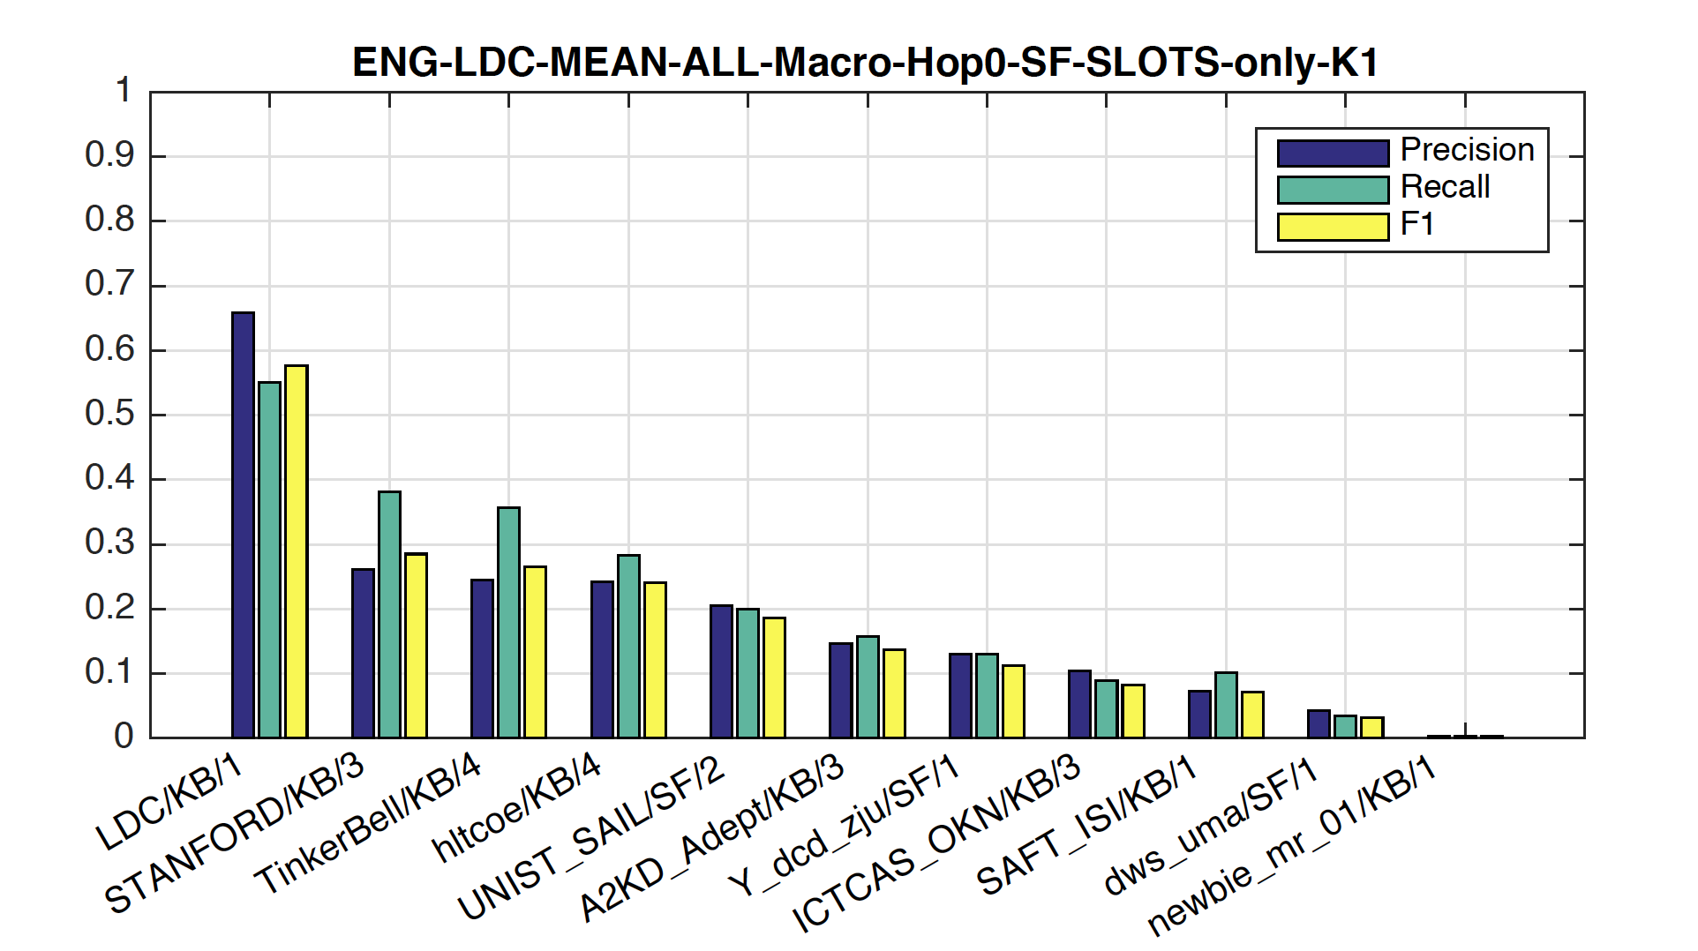
The task is hard
Best 2017 system: F1=0.29 for English hop 0 queries.

Slide 26
Current work 1: improving Kelvin
Upgrade components to use newer machine learning approaches
Enhance Kripke entity clustering with more data (nominal mentions, embeddings)
Add tensor-decomposition based learning to identify likely/unlikely relations
Add other components to detect and fix “dubious facts”

Slide 27
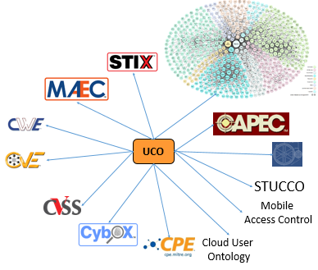
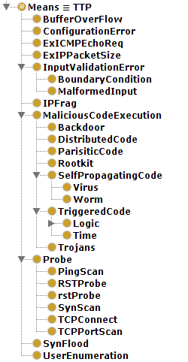
Current work 2: cybersecurity
UMBC is working with IBM on extracting cybersecurity information from text
Describe entities, relations & events using UCO, the Unified Cybersecurity Ontology
Rich schema supports reasoning
Better data sharing, interoperability, integration and human understanding
Link to background knowledge graphs and common metadata models (CVE, Stix, Cybox…)
Use graph to enhance analytics and machine learning for intrusion detection systems
http://unifiedCyberOntology.github.io

Slide 28
Lessons Learned
We always have to mind precision & recall
Extracting information from text is inherently noisy; reading more text helps both
Using machine learning at every level is important
Making more use of probabilities will help
Extracting information about a events is hard
Modelling the temporal extent of relations is important, but still a challenge

Slide 29
For more information, contact finin@umbc.edu

